Slide 1
Problem Analysis and Performance Tuning for CICS
Clive Harriss – Senior Solutions Advisor
Rocket Software
Notes:
Welcome, my name is Clive Harriss, I am a Senior Solutions Advisor for Rocket Software, and today I will be talking about problem analysis and performance tuning for CICS.

Slide 2
Challenges faced across the organization
IBM CICS Performance Analyzer for z/OS
1
4
2
Detect, Verify (analyze) and Solve Method
5
Rocket C\Prof
IBM Z OMEGAMON for CICS
Summary
3
6
Notes:
I will discuss the challenges faced in running, monitoring and tuning CICS systems and applications;
A methodology for finding, handling and resolving CICS problems and where the 3 CICS products here fit in helping to solve performance issues.
Then I will talk about key values each of these 3 CICS products deliver in more detail that individually help with performance problems, but when put together can provide a solution to solving even the most difficult problems.

Slide 3





Challenges across the Organization
“I need to get my business results fast and accurate. What’s going on ?”
“Performance problems seem to appear without warning and deep technical skills are hard to find.”
“We can’t test fast enough for changing workloads because we don’t have enough resources.”
“I need to keep making application changes to meet new business changes”
“I’m getting too many alerts. I need to pinpoint the most important ones.”
Notes:
As in any organization, the challenges faced depend on the role and perspective of the person raising them.
How often have your heard people in these role say:
LOB Manager - “I need to get my business results fast and accurate. What’s going on ?”
IT Manager - “For me, Performance problems seem to appear without warning and deep technical skills are hard to find.”
QA Manager - “We can’t test for changing workloads in today’s digital economy since we don’t have enough resources.”
Developer - “I have to keep up with application changes as we expand our markets worldwide and adopt more users.”
CICS Systems Programmer - “I’m getting too many performance alerts. I need to be able to pinpoint the ones that are most important.”
CICS Problems, whether they are related to performance or transaction failures, can in some cases be easily remediated in the short term but getting to the root cause of the problem and creating a permanent fix, so they no longer occur, can be quite a bit more difficult.
Furthermore, we have the challenge of addressing performance issues with application workloads that always seem to be changing.

Slide 4
CICS Performance / Problem Analysis
Deep Dive Application Analysis
Monitoring and alerting
Problem Analysis
Notes:
Performance issues are typically reported where the response time for output is longer than the expected time for the execution and can be real and happening, anticipated or expected and sometimes perceived to be a problem.
We need a systematic approach to allow us to:
Establish and measure metrics that categorize acceptable behavior.
Monitor the performance of the system against those metrics and alert us to unexpected changes or variations
Identify the part of the system, the bottleneck, and capture the data critical for problem analysis.
Dig down into the roots of the problem, find the cause and modify the system to remove it.
With the key being to have a clearly understand and prepared methodology to Detect, Verify and Solve performance issues and problems when they arise.

Slide 5
Detect, Verify (Analyze) and Solve
Detect – Requires some form of system monitoring
IBM OMEGAMON for CICS on z/OS allows users to:
Avoid/delay costly slow downs and outages by monitoring key CICS resources and workloads and be alerted of any issues.
Reduce time-to-resolution of problems by quickly pinpointing and isolating problems.
Maximize overall efficiency by leveraging integration of z/OS platform information with other OMEGAMONs for a total picture of your multi-functional core business workloads.
Access to historical data limited
Notes:
So let us look at Detect.
It is essential to be able to collect sufficient and the right data to monitor, and alert as problems arise and allow action before they get out of hand.
But this allows us to act in the moment but provides limited data to look back, review and get a wider perspective of how the system was running at the time.

Slide 6
Detect, Verify (Analyze) and Solve
Verify – Requires a tool that can review long term data.
IBM CICS Performance Analyzer (PA) for z/OS:
A powerful offline reporting tool to help you develop, tune, and manage your CICS systems.
CICS PA addresses the needs of everyone involved in CICS performance analysis, system tuning, and planning capacity.
Includes those who architect, develop, deploy, and manage complex mainframe CICS applications.
Access to Forensic Application Data Limited
Notes:
To verify and analyse a performance problem, after it has been detected, we need to build a historical perspective and a wider picture of what was happening before, during and after a problem arises.
However, even with the reports from CICS PA we are left needing to find a way forensically analyse and deep dive into the problem application or program.

Slide 7
Detect, Verify (Analyze) and Solve
Solve – Requires a tool that can forensically analyze application flow.
Rocket C\Prof
Reproducing a problem and identifying solutions with existing tools can be tedious, time consuming, and expensive.
Rocket C\Prof helps organizations get more business and operational value from IBM CICS internal trace data while it protects your IBM z/OS mainframe environment.
Rocket C\Prof provides the added details you need to diagnose problems in your CICS applications faster—with minimal impact on your business-critical applications.
Access to data for deep dive application analysis
Notes:
C\Prof

Slide 8

Detect
IBM Z OMEGAMON for CICS
Taking a closer look
Deep Dive Application Analysis
Problem Analysis

Slide 9
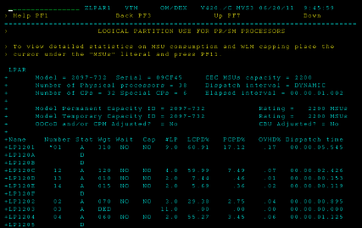
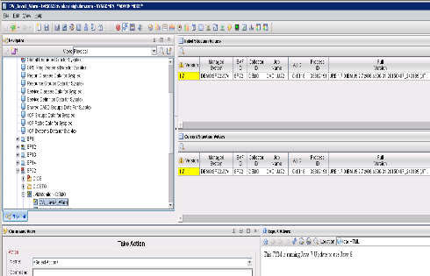
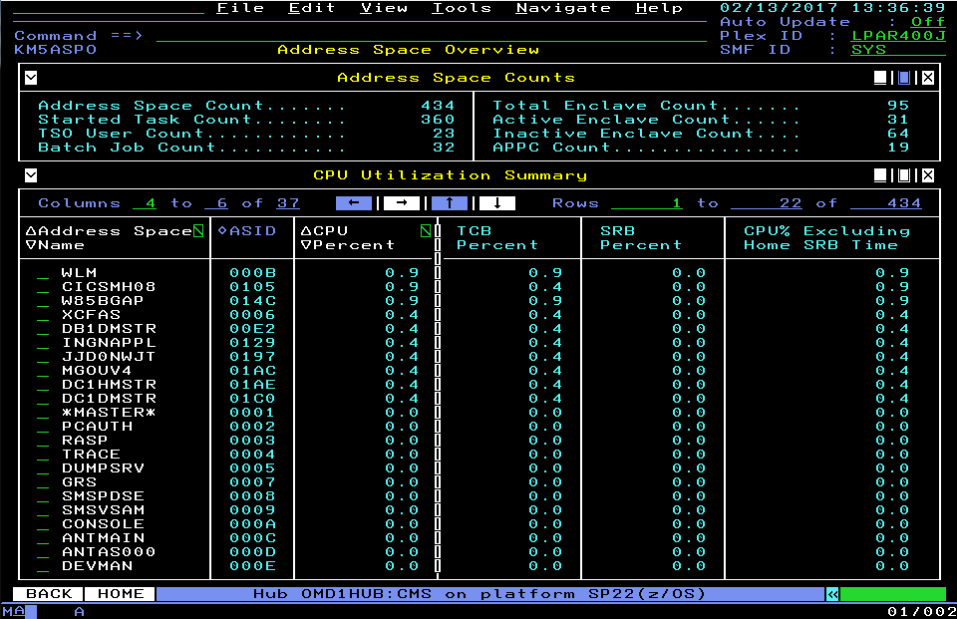
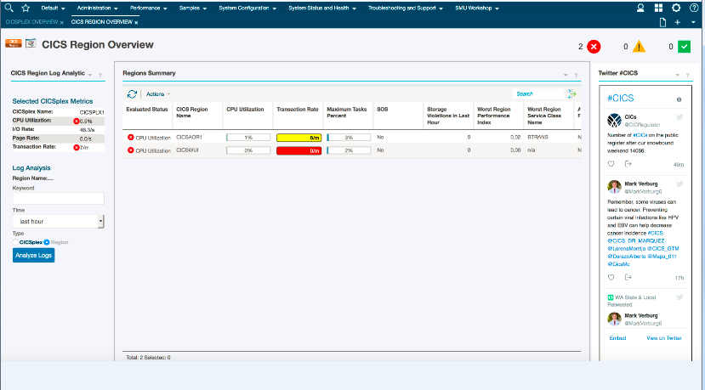
IBM Z OMEGAMON for CICS Overview
Some of the improvements made over the years:
CICSplex wide data viewing and summarization
Real-time and Historical Data Collection and Reporting
Application Trace Facility
Bottleneck Analysis
Resource Limiting
Proactive Alerting
Task History collection
New CICS metrics and statistics
CICS TG support
Updated User Interfaces
Integration with other OMEGAMONs and other tooling
Day 1 Support for CICS V5.6 released in June 2022
Notes:
If you're a large organization, you probably have a CICS Plex, that's how you manage your CICS regions and with OMEGAMON for CICS you can drill down from the CICS Plex to the individual regions and down to the individual tasks to find the problem.
It provides historical data collection and reporting, which gives you the ability to analyze what went wrong, it has application trace facility as well as bottleneck analysis to see why two tasks are hanging and task history collection.
It has support for CICS Transaction Gateway and integrates with other OMEGAMON family products, so for example, you can drill across from OMEGAMON for CICS into OMEGAMON for Db2 if you think that the problem associated with your CICS transaction is sitting inside of the world of Db2 and back in context.
OMEGAMON for CICS itself also can remediate the problem if you set it up properly to do so.
For example , you can say, if I find these 2 tasks hanging for longer than X, during this time period, I will get OMEGAMON to cancel them and get the system up and running again.
We provide Day 1 support for new releases of CICS, including beta clients. In June 2022, the latest version of OMEGAMON 5.6 was released together with CICS V6.1.

Slide 10
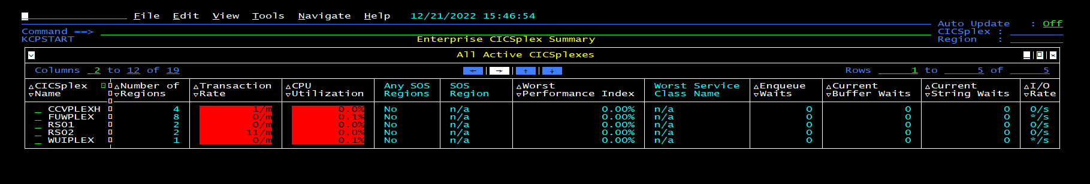
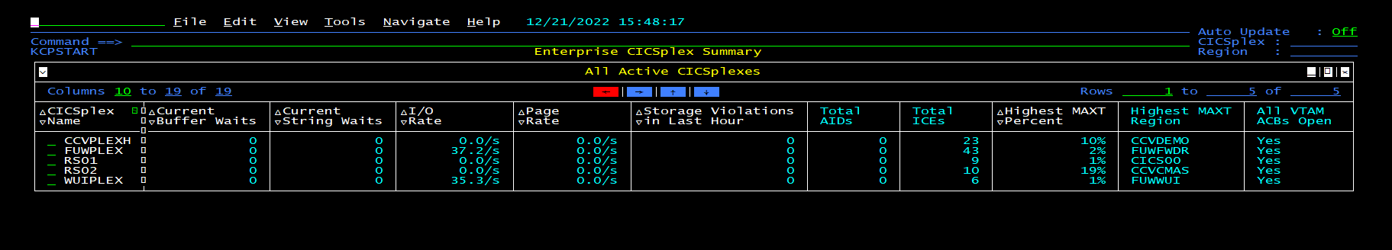
CICSplex Summary Screen
Notes:
So, here's some sample screens for you
.
When I start out, I started out at the CICS Plex level so at the top of the screen, you'll see, I'm seeing the enterprise CICS Plex Summary.
I'm starting at the CICS Plex and I have, what appears to be 6 OMEGAMON CICS PLEXes and you could see the transaction rate CPU utilization.
And you could set thresholds, so these are colored in different manners.
If you set the threshold properly, you know, exactly where you need to drill down in terms of CICSPlex to look at the problem.

Slide 11
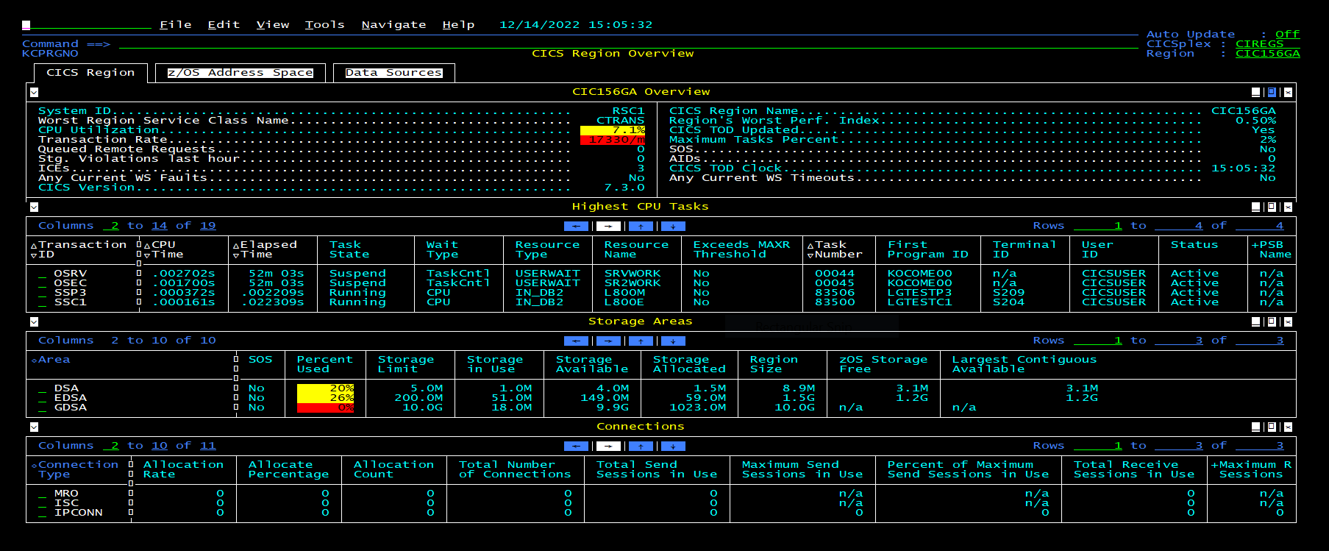
Region Overview Screen
Notes:
When you drill down into a CICSPlex, you end up with a list of regions, but you can then drill down to get the region overview, the highest CPU task so you get a list of tasks.
You can see how your dynamic storage areas are doing and you can see how the connectivity to this CICS region is performing as well.
Again, you can set thresholds and you could set them to yellow red or any other color, 7 or 8 different colours available to you.
So, that that identifies this is something I need to drill down and look at.

Slide 12
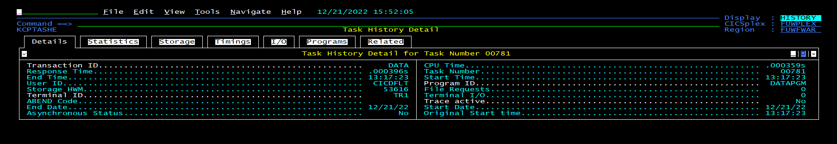
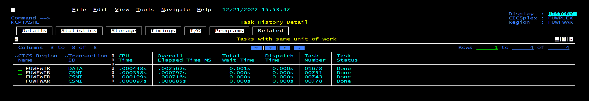
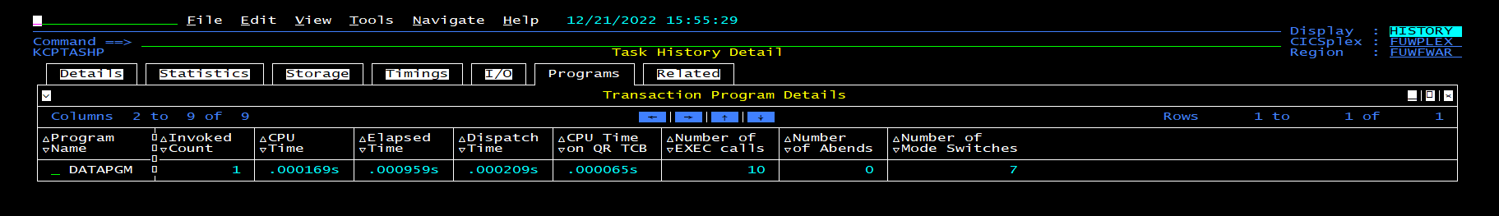
Task History Detail Screen - tabs

Slide 13
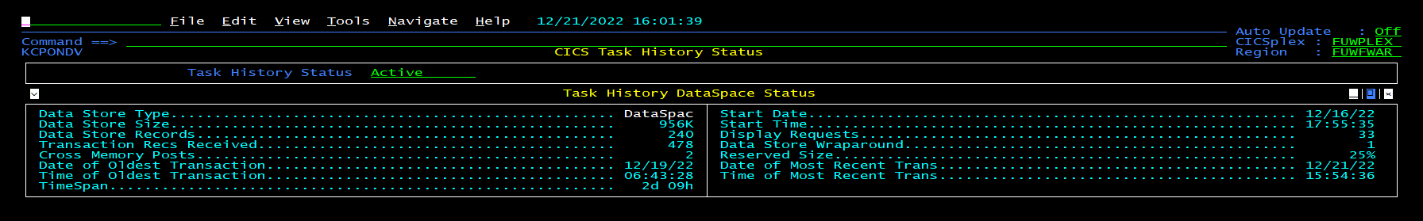
Task History Collection - timespan
OMEGAMON can detect, and in some cases remediate problems
However, permanently solving problems require further analysis
Task History data in OMEGAMON is only kept for a short period of time
Some problems require analyzing data collected over several months…

Slide 14
Verify (Analyze)
IBM CICS Performance Analyzer
for z/OS
Taking a closer look
Monitoring and alerting
Problem Analysis
Deep Dive Application Analysis

Slide 15
What is IBM CICS Performance Analyzer (PA)?
A comprehensive off-line performance reporting and analysis tool for CICS that provides ongoing system management and measurement reports on all aspects of CICS application performance.
It can report on the SMF records created by the CICS monitoring facility, CICS statistics, DB2 accounting, IBM MQ accounting, and logstream data written by the MVS System Logger.
SMF
report
performance and statistics
reports
Uses SMF data as input
Easy to use interface for report generation (over 250 supplied report forms)
Performance and statistical analysis
Graphical performance analysis via CICS Explorer
15
Notes:
How does it work?
Uses SMF data as input
Easy to use interface for report generation (over 250 supplied report forms)
Performance and statistical analysis
Graphical performance analysis via CICS Explorer

Slide 16

What is the value of CICA PA and why is it important?
Analyze CICS application performance
Improve CICS resource usage
Evaluate the effects of CICS tuning efforts
Help improve transaction response time
Provide ongoing system management and measurement reports
Increase availability of resources
Increase the productivity of system and application programmers
Provide awareness of usage trends
Reduce time and resource required to analyze offline performance data
Enables deep-dive CICS performance analysis and understanding of usage trends
Aids capacity planning and tuning
Help quickly identify trends, anticipate and prevent online performance problems
16
Notes:
Why is that important?
Reduce time and resource required to analyze offline performance data
Enables deep-dive CICS performance analysis and understanding of usage trends
Aids capacity planning and tuning
Can be used to quickly identify trends, anticipate and prevent potential online performance problems

Slide 17

The benefits of using CICS PA
Ease of use
Uses an ISPF dialog to build, maintain, and submit reports
Statistics reporting capability
Transaction profiling
Helps identify trends over time
Can assist in capacity planning
This Photo by Unknown Author is licensed under CC BY-SA
Notes:
Ease of use
No additional setup or customization required. Uses familiar CICS terms and concepts
Provides an ISPF dialog to build, maintain, and submit reports that you can tailor your reports easily using report forms
Extensive online help available, and field descriptions
Trend and capacity planning
Statistics reporting capability
Comprehensive reporting and analysis of CICS statistics data
Alert processing to highlight potential tuning opportunities
Transaction profiling
Compares transaction performance between two time periods

Slide 18
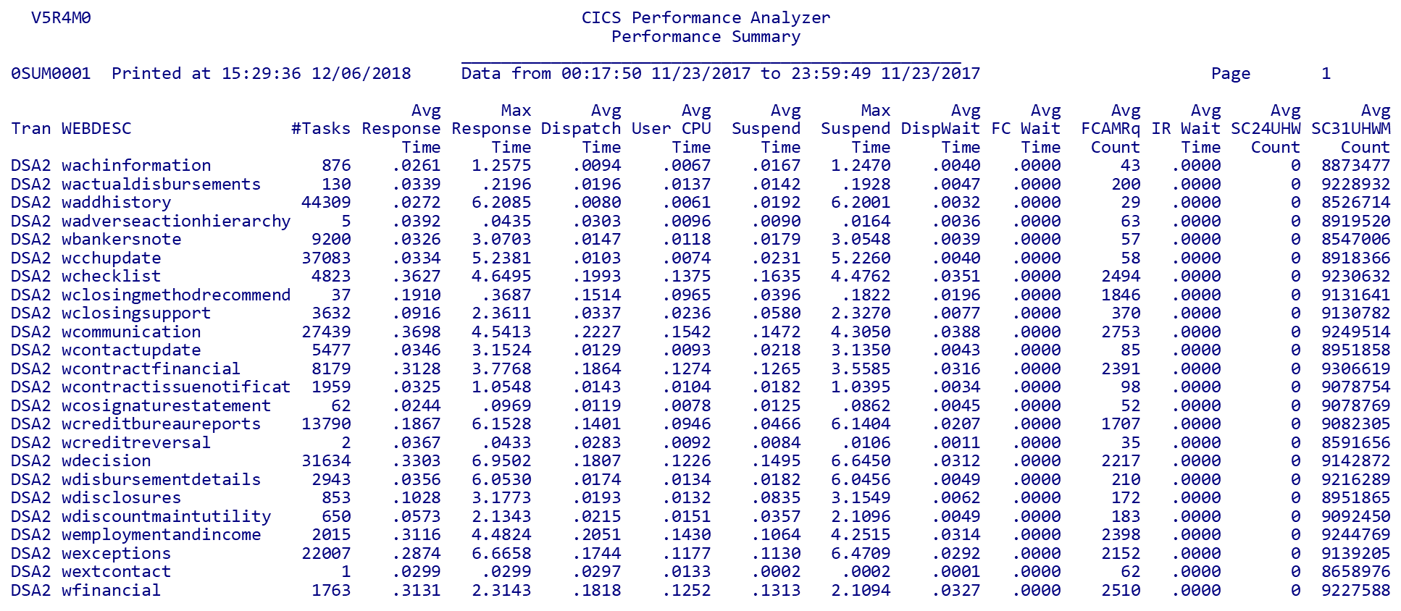
Performance Summary Screen
Notes:
Here is a typical Performance Summary report from CICS PA showing ………..

Slide 19
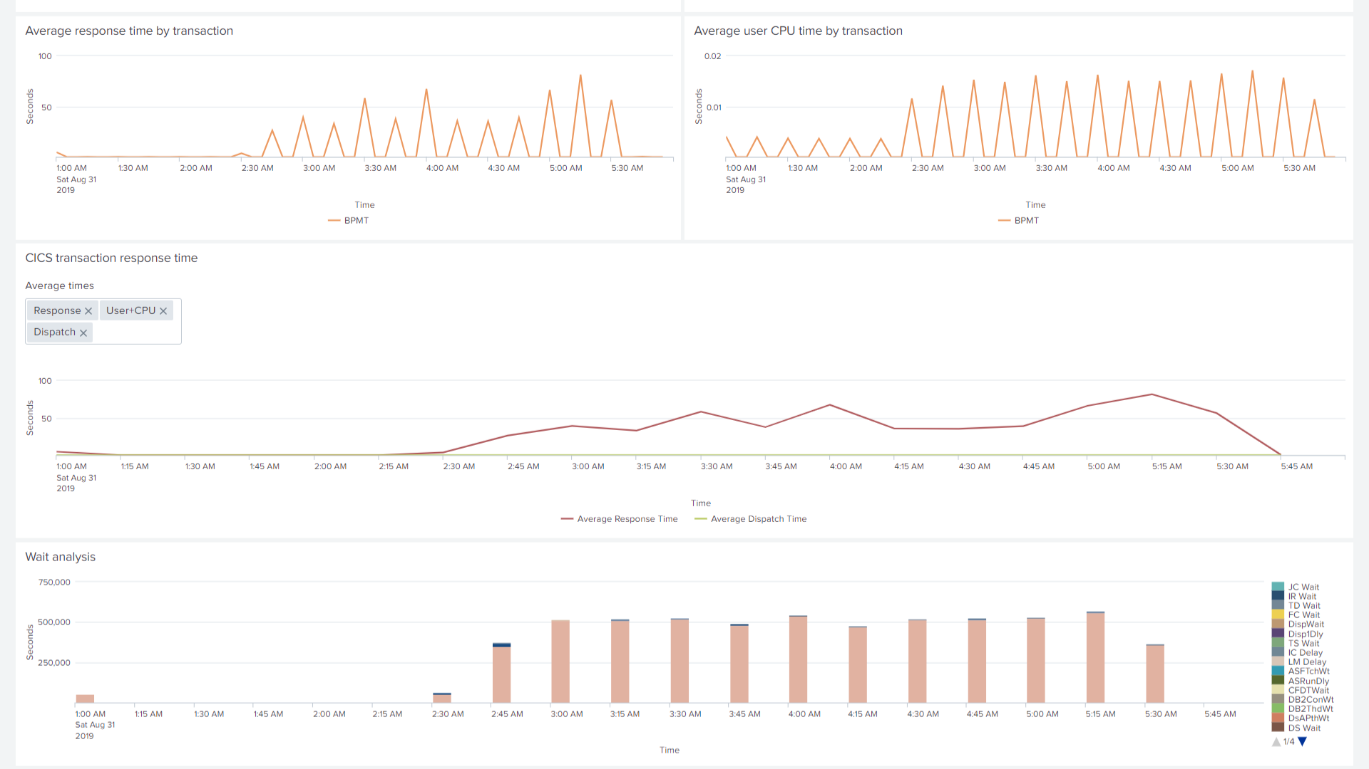
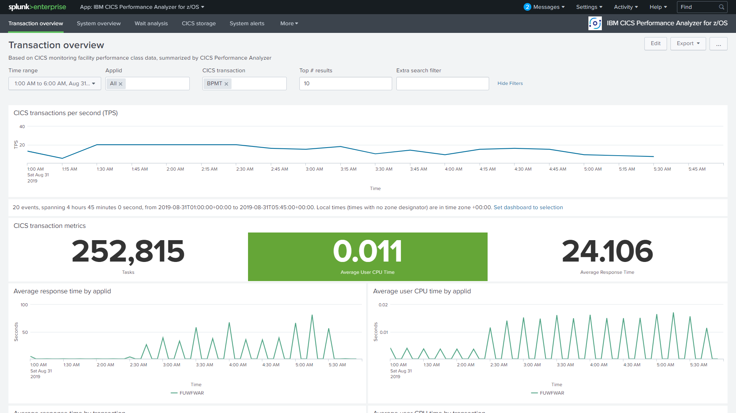
Visualization with Splunk or Elastic Dashboards
Sample Splunk app showing performance summary data from CICS PA
Sample Splunk app

Slide 20
Solve
Rocket C\Prof
Taking a closer look
Problem Analysis
Deep Dive Application Analysis
Monitoring and alerting
Rocket C\Prof
Problem Analysis

Slide 21

What is C\PROF
A new way of analyzing problems in CICS by exposing the intrinsic value of the CICS internal trace
Requires no changes to CICS itself, exits, agents, or resource definitions.
CICS is unaware of C\Prof activity and is completely unaffected by it.
It is a lightweight, low-overhead solution
Has both ISPF and Web UI (browser-based) user interfaces
Ideal for permanent use in development environments
This Photo by Unknown Author is licensed under CC BY-SA
Notes:
A completely new approach to trace capture
Uses significantly less CPU than traditional tools
Does not require changes to CICS
With C\Prof, the CICS trace becomes:
Inexpensive to capture
Simple to interpret
C\Prof unlocks the hidden value of the trace
Low CPU usage means you can run it in production
Ideal for permanent use in development environments
Has both ISPF and Web UI (browser-based) user interfaces to provide an analysis capability that is better than an application trace facility.

Slide 22
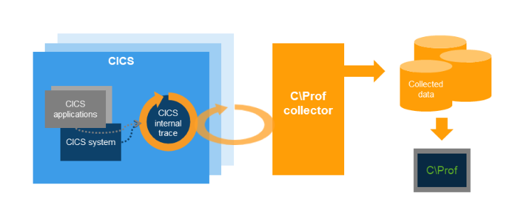
C\Prof: How does it work?
The C\Prof collection task (or server) collects and stores data from the CICS internal trace.
The Collector runs in separate MVS address space and peeks inside CICS to gather data
Can collect data from one region or multiple regions with same collector
Notes:
C\Prof peeks inside CICS to look at CICS internal trace and CICS is unaware that this is happening
The CICS internal trace is a circular buffer in which the oldest trace entries are continuously being overwritten with new entries due to ongoing activity in CICS. If a problem occurs in CICS, trace events relating to recent problems in CICS will persist inside the CICS internal trace for a period before they are eventually overwritten by newer entries
C\Prof writes the trace to special profiling or auxiliary trace data sets with you controlling the level of detail is only limited to what is stored in the trace You can collect all the time, in a short burst, or take a quick snapshot
Use C\Prof to filter and sort transactions, view application events, dive into the trace events themselves. It supports regions using MRO
Events inside the CICS internal trace are captured by the C\Prof collection task (collector). Run C\Prof as a collection server servicing requests from either the ISPF dialog or the C\Prof Web UI, or submit ad hoc batch requests using JCL

Slide 23

C\Prof: Highlights
Simple to get started (< 30 minutes)
Transaction data supplied in near-real time
Single Point of Control (SPOC) via the C\Prof Region List
Gives an “application” view of your trace events:
Adjustable trace levels
A unique snap feature allows you to take a point-in-time snapshot of the CICS internal trace
Produce output identical to the CICS auxiliary trace facility but at much lower processing cost
Notes:
Simple to get started (< 30 minutes)
Transaction data supplied in near-real time
Single Point of Control (SPOC) via the C\Prof Region List
An “application” view of your trace events:
Collect event data from the CICS internal trace
Find your transaction
Drill down to application events, performance information, transaction breakdown by program, trace event “deep dive”
Adjustable trace levels
Add additional trace points for more detail
All the features of the CICS auxiliary trace but much more

Slide 24


Multiple trace capture modes
Record
Record for Profiling – our premiere feature
Record to Auxiliary Trace Data Sets
Snap (snapshot)
Take a point-in-time snapshot of the CICS internal trace
Snap looks backward to see what recently occurred in CICS
Works even if the collector was not running at the time
Combine with automation products for automated problem capture
Notes:
Record
Record the contents of the CICS internal trace
Two modes:
Record for Profiling – our premiere feature
Application perspective of the trace
Stored in C\Prof archive data sets
View transaction list, application events, program calls, trace events…
Record to Auxiliary Trace Data Sets
Output similar to the CICS auxiliary trace facility but with a lot less overhead and more recording options
Snap (snapshot)
Take a point-in-time snapshot of the CICS internal trace
Captures a copy of what is currently there
Effect?
Snap looks backward to see what recently occurred in CICS
Works even if the collector was not running at the time
Combine with automation products for automated problem capture

Slide 25
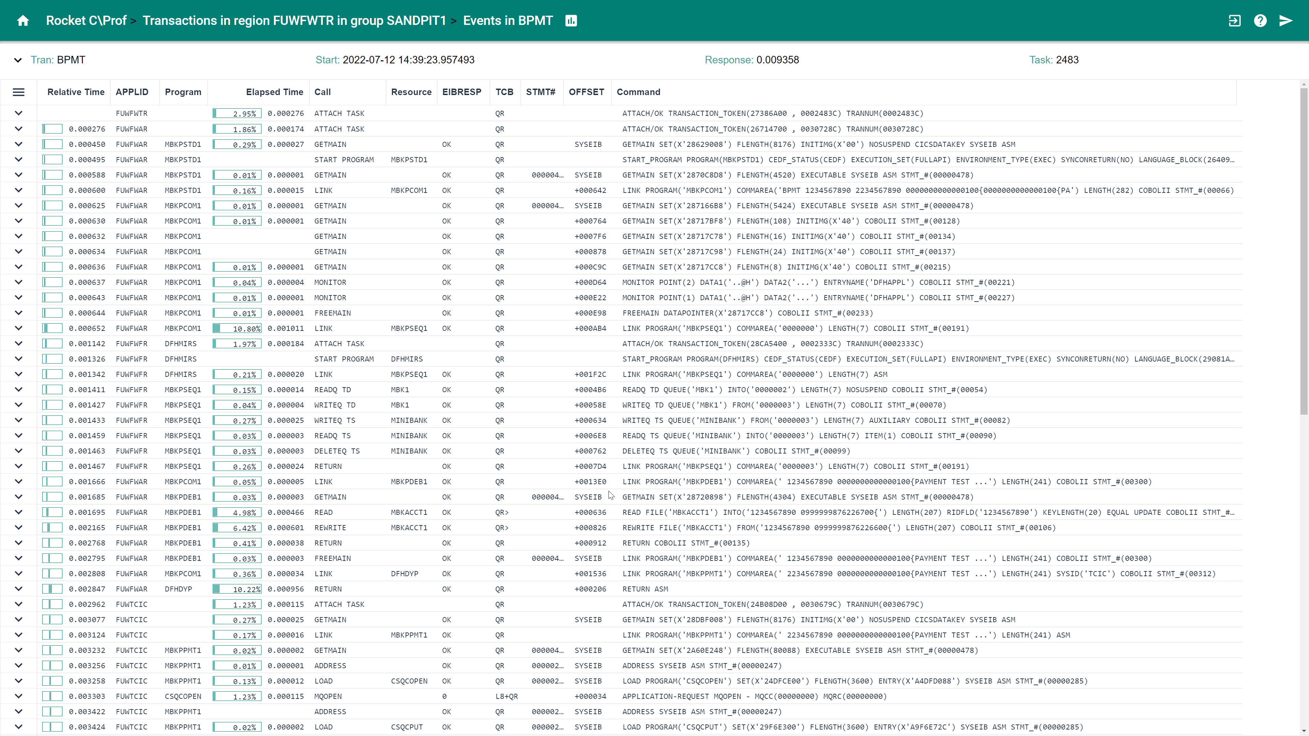
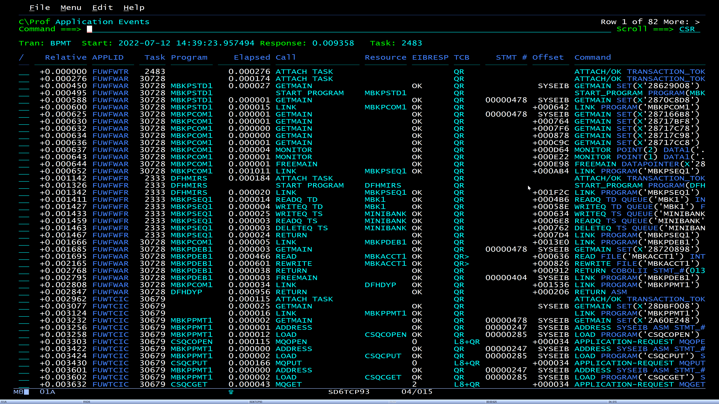
C\Prof translates this …
AP 1790 TFXM ENTRY - FUNCTION(INIT_XM_CLIENT) CLIENT_REQUEST_BLOCK(2708F570 , 02A00000)
TASK-01629 KE_NUM-0286 TCB-C/QR /008F63C8 RET-A47683E0 TIME-00:25:52.3404031650 INTERVAL-00.0000020239 =0000058
1-0000 00480000 000000B3 00000000 00000000 BFC00000 00000000 01000100 2708F570 *.................{............5.*
0020 02A00000 00000000 00000000 00020000 00000000 00000000 DBC862DE C5240D60 *.........................H..E..-*
0040 00000000 00000000 *........ *
2-0000 C3D7F3F6 91F20006 2732D040 2732D040 00000000 0001629C *CP36j2....} ..} ........ *
XM 1001 XMIQ ENTRY - FUNCTION(SET_TRANSACTION) FACILITY_TYPE(TERMINAL) FACILITY_TOKEN(2708F570)
TASK-01629 KE_NUM-0286 TCB-C/QR /008F63C8 RET-A5A68922 TIME-00:25:52.3404045825 INTERVAL-00.0000014174 =0000059
1-0000 01380000 000000A1 00000000 00000000 B1000000 00080000 03A85530 26EEF160 *.........................y....1-*
0020 2702E0E8 1790E0D8 26EEDFE0 00000048 2708F570 00000018 00000000 15672700 *..\Y..\Q...\......5.............*
0040 15000000 00000000 273C96CD 00000000 00000000 2474E310 00000000 2474E460 *..........o...........T.......U-*
0060 00000000 2474E572 00000000 2474E310 00000000 2474E89C 00000000 2474EC10 *......V.......T.......Y.........*
0080 C9E401D9 24A0B250 F0F3F8C8 24AFED40 000002D0 C6F4E2C1 00000000 2474EFC2 *IU.R...&038H... ...}F4SA.......B*
00A0 00000000 2474EB84 00000000 2474EF40 0000001E 2708F570 0000001E 8C97459B *.......d....... ......5......p..*
00C0 00000000 00000000 00000000 00000000 00000000 26EEF430 00000000 00000000 *......................4.........*
00E0 00000000 00000000 00000000 E3E2F8F0 F0F74040 00000000 00000000 00009508 *............TS8007 ..........n.*
0100 00000000 00009508 00000000 00009508 00000000 00000000 00000000 024D47D6 *......n.......n..............(.O*
0120 00000000 024D47D6 00000000 00000000 00000000 00000000 *.....(.O................ *
XM 1002 XMIQ EXIT - FUNCTION(SET_TRANSACTION) RESPONSE(OK)
TASK-01629 KE_NUM-0286 TCB-C/QR /008F63C8 RET-A5A68922 TIME-00:25:52.3404064179 INTERVAL-00.0000018354 =0000060
1-0000 01380000 000000A1 00000000 00000000 B1000000 00080000 03A80130 26EEF160 *.........................y....1-*
0020 2702E0E8 1790E0D8 26EEDFE0 00000048 2708F570 00000018 00000000 15672700 *..\Y..\Q...\......5.............*
0040 15000000 00000000 273C96CD 00000000 00000000 2474E310 00000000 2474E460 *..........o...........T.......U-*
0060 00000000 2474E572 00000000 2474E310 00000000 2474E89C 00000000 2474EC10 *......V.......T.......Y.........*
0080 C9E401D9 24A0B250 F0F3F8C8 24AFED40 000002D0 C6F4E2C1 00000000 2474EFC2 *IU.R...&038H... ...}F4SA.......B*
00A0 00000000 2474EB84 00000000 2474EF40 0000001E 2708F570 0000001E 8C97459B *.......d....... ......5......p..*
00C0 00000000 00000000 00000000 00000000 00000000 26EEF430 00000000 00000000 *......................4.........*
00E0 00000000 00000000 00000000 E3E2F8F0 F0F74040 00000000 00000000 00009508 *............TS8007 ..........n.*
0100 00000000 00009508 00000000 00009508 00000000 00000000 00000000 024D47D6 *......n.......n..............(.O*
0120 00000000 024D47D6 00000000 00000000 00000000 00000000 *.....(.O................ *

Slide 26
Summary
IBM Z OMEGAMON for CICS
Detect
Rocket
C\Prof
IBM CICS Performance Analyzer
for z/OS
Solve
Verify
Notes:
At the start of this presentation, I said I would talk about a methodology for finding and resolving CICS problems whether they are related to performance or outages;
I then talked about three CICS products that can be used to detect, analyze and solve performance problems, what special features each tool brought and how each tool fitted into that methodology.
Then provided a high-level overview of the key added value each tool brings, and how by using them together with a simple Detect, Verfiy and Solve methodology you can monitor, manage and improve the performance of your CICS systems and CICS applications.

